Slide 1
CYB 206:Enterprise and Perimeter Security
Ageebee Silas Faki phd
08066238988, ageebeefaki@gmail.com, faki.silas@binghamuni.edu.ng

Slide 2
Network Attacks and Defence Strategy
Objectives:
Definition of Enterprise and Perimeter Security
introduces essential terminologies and concepts that serve as a foundation for the understanding of network attacks.
Different level of attacks

Slide 3
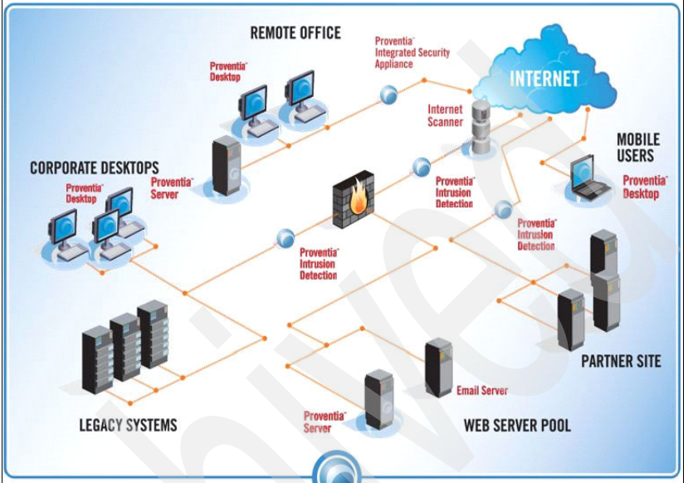

Slide 4
Enterprise Security
Enterprise security involves the various technologies, tactics, and processes used to protect digital assets against unauthorized use, abuse, or infiltration by threat actors.
Enterprise security includes the protection of data as it flows across networks, including those connecting satellite offices and those that tie data into the general internet
Enterprise security systems also cover the people and policies that organizations use to secure their network infrastructure including assets such as devices and various endpoints.
it also takes into consideration the legal structures that apply to an organization’s data.

Slide 5
Perimeter Security
Perimeter security involves safeguarding a company’s network limits from hackers, intruders, and other unwanted individuals.
It includes surveillance detection, analyzing patterns, recognizing threats, and dealing with them effectively
Some of the components of perimeter security are
Firewalls
border routers
Intrusion Detection Systems (IDS)
Intrusion Prevention Systems (IPS)
Unified Threat Management (UTM) systems etc

Slide 6
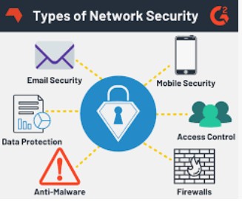
Enterprise and Perimeter security Practice
Few best practices are:
Guard data
Set up Stringent Control
Set up Disasters recovery
Teach Employees
Manage End Point Access

Slide 7
Essential Terminologies Related to Network Security Attacks
Understanding the tactics and techniques adopted by attackers is key to successful cyber defense (network).
This we help know how to:
Design our network to limit attacks
What policy should be applied to the network to minimize attacks

Slide 8
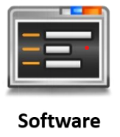
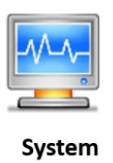

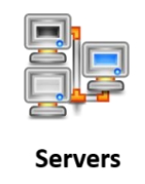
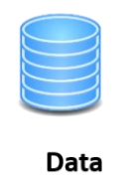
Terminologies
Asset: An asset is anything that can be of interest to an attacker.
It can be a tangible or Intangible resource in an organization
Examples of tangible assets of an organization include databases, the server that hosts the databases, and the network that provides connections to the server.
The intangible assets include the organization’s secrets, critical business process and its reputation

Slide 9
Terminologies
While not all assets of an organization are of equal importance, critical assets should be protected from unauthorized access to prevent loss to the organization
Threat: A threat is a potential occurrence of an undesirable event that can eventually damage and disrupt the operational and functional activities of an organization
Threat is always on organizational asset (critical asset)

Slide 10
Terminologies
Threat Sources: There are various sources from which threats originate, which can be broadly classified as natural threats, unintentional threats, and intentional threats.
Threat sources are from different classes.
classification of threat sources next slide

Slide 11
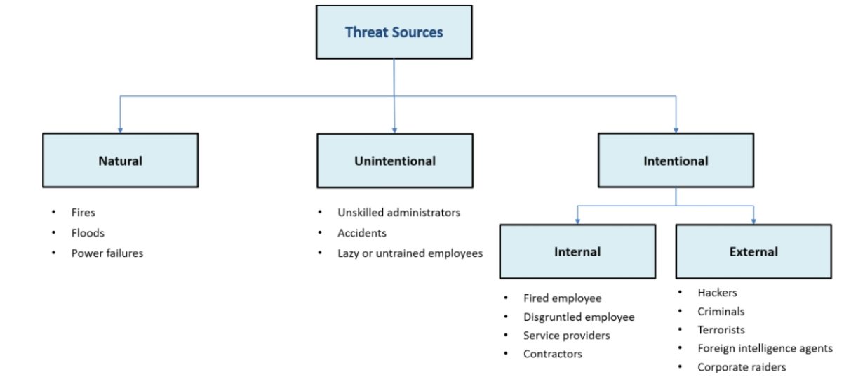
Classification of threat sources

Slide 12
Threat Actors
Threat Actors/Agents: threat actor or agent is an individual or entity that breaks into a system to achieve a specific goal such as impacting the security of an individual or organization,
.Whether intentionally or unintentionally
While a threat actor may refer to an attacker, it is a more generic term that may also refer to an individual who causes a security incident due to negligence, error, or as a result of social espionage.
Threat actors can be internal or external, and skilled or unskilled. Skilled threat actors are called hackers and security attackers

Slide 13
Types of Threat Actors
The types of threat actors, based on their motivation and the approaches they adopt to compromise the security of a network, are as follows
Hacktivists: Individuals who use hacking as a means to promote a political or social agenda, rather than for monetary gains. They typically tend to deface or disable websites, and bring networks down via distributed denial of service (DDoS) attacks.
Cyber Terrorists/Criminals: Individuals with a wide range of skills, like phishing and ransomware, motivated by religious beliefs, political beliefs, or monetary gains, to create threats of large-scale disruption of computer networks.

Slide 14
Suicide Hackers: Individuals who aim to bring down the critical infrastructure for a “cause,” and are not deterred by potential jail terms or other forms of punishment. They may sacrifice their lives for an attack.
State-Sponsored Hackers: Individuals employed by the government to penetrate and obtain top-secret information, and to damage information systems of other governments. These hackers infiltrate large organizations to steal mission-critical information.
Organized Hackers: Professional hackers who attack a system for profits. They hack to obtain sensitive information such as social credit card information, security numbers, and monetary information

Slide 15
Script Kiddies: Unskilled individuals who compromise a system by running scripts, tools, and software developed by professional hackers. They attempt to emulate the attacks of skilled hackers.
Industrial Spies: Individuals who attempt to attack companies for commercial purposes. These attackers are hired by business competitors or agencies to steal an organization’s strategy, money records, and other sensitive data.
Insider Threat Actors: Individuals such as disgruntled employees and terminated employees, who intentionally provide an organization’s data to others for money or revenge. Undertrained staff may also unintentionally provide critical information when subject to social engineering attack

Slide 16
Vulnerability
Vulnerability refers to the existence of a weakness in the design or implementation of a system that can be exploited to compromise the security of the system.
Frequently, it is a security loophole that enables an attacker to enter the system by bypassing user authentications

Slide 17
Common causes for vulnerabilities
Hardware or software misconfiguration
Insecure or Poor Design of a Network
An insecure configuration of the hardware or software in the network can lead to security loopholes.
For example, a misconfiguration or the use of an unencrypted protocol may lead to network intrusions, resulting in a leak of sensitive information
An improper and insecure design of the network may make it susceptible to a variety of threats and potential data loss.
For example, if firewalls, IDS and virtual private network (VPN) technologies are not implemented securely, they can expose the network to numerous threats.

Slide 18
Inherent technology Weakness
If the hardware or software is not capable of defending the network against certain types of attacks, it will be vulnerable to those attacks.
Certain hardware, applications or web browsers tend to be more prone to attacks such as denial-of-service or man-in-the-middle (MITM) attacks.
For example, systems running old versions of web browsers are more prone to being vulnerable to distributed attacks

Slide 19
End-User Carelessness
Intentional end-user acts
End-user carelessness considerably impacts network security.
Human behaviour is fairly susceptible to various types of attacks especially various social engineering techniques.
Ex-employees who continue to have access to shared drives can misuse them by leaking the company’s sensitive information.

Slide 20
Examples of Security Vulnerabilities
Technological vulnerabilities
Technological vulnerabilities exist due to inherent weaknesses in operating systems, printers, scanners, or other networking equipment.
Attackers can detect loopholes in protocols such as SMTP, FTP, and ICMP. Attackers can also detect the absence of authentication in networking equipment like switches and routers to effect an intrusion.
Regular security audits by the network defender or information security officer can help monitor such irregular activities on the network.

Slide 21
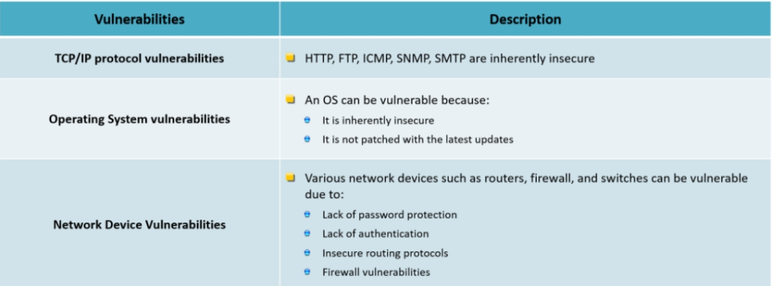
Sample of technology vulnerability

Slide 22
Configuration Vulnerability
Configuration vulnerabilities exist due to the misconfiguration of computing and network devices.
For example, vulnerabilities are created when a network defender configures a user account or system service insecurely such as by leaving the default settings unchanged or by improper password management.

Slide 23
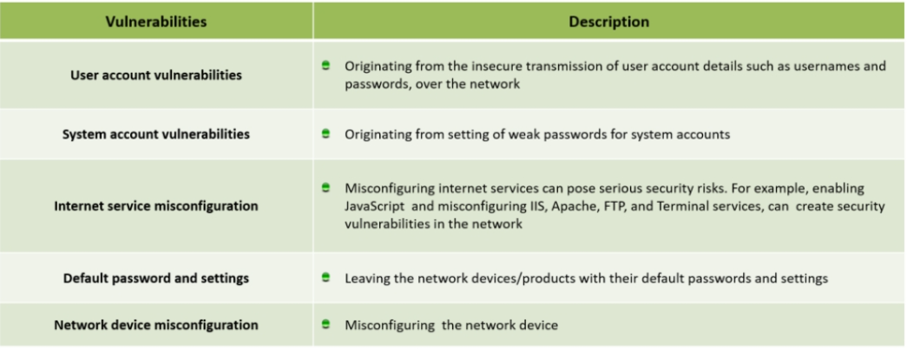
Sample of configuration vulnerabilities

Slide 24
Security policy vulnerabilities
Security policy vulnerabilities exist when there are an improper drafting and enforcement of security policies in the organization.
Lack of appropriate policy enforcement may lead to unauthorized access to network resources.
For example, failure to regularly monitor and audit the activities in a system by network defender can enable attackers to exploit the system

Slide 25
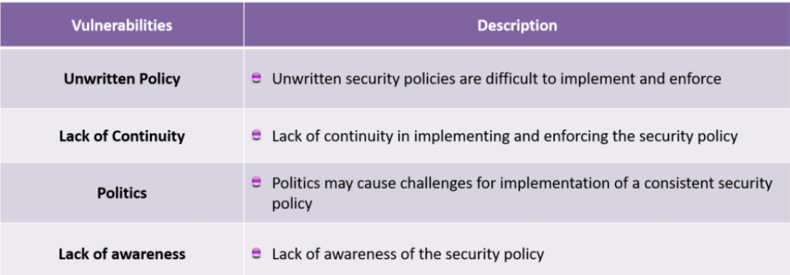
Sample Security Policies Vulnerabilities

Slide 26
Risk
Risk Risk refers to the potential loss or damage that can occur when a threat to an asset exists in the
presence of a vulnerability that can be exploited to compromise the asset.
Therefore, a risk can be thought of as the intersection of an asset, threat, and vulnerability.
Risk = Asset + Threat + Vulnerability

Slide 27
Attack
An attack is an action that is performed with the intent to breach an IT system’s security by exploiting its vulnerabilities.
An attack involves an attempt to obtain, edit, remove, destroy, implant, or reveal information without authorized access.
It also refers to malicious software or commands that exploit vulnerabilities to cause unanticipated behaviour in legitimate software or hardware.
Therefore, an attack can be conceptualized as combination of a motive, with a method to perform the attack, which exploits one or more vulnerabilities in the system.
Attacks = Motive (Goal) + Method + Vulnerability

Slide 28
Motive
Attackers are generally driven by specific motives (goals) and objectives for performing cybersecurity attacks.
Examples of motives are:
Disrupting business continuity
Information theft
Manipulating data
Damaging reputation of the target

Slide 29
Methods
Methods (TTPs)
The terms tactics, techniques, and procedures (TTPs) refer to the patterns of activities and methods associated with specific threat actors or groups of threat actors.
TTPs are helpful in analysing threats and profiling threat actors and can further be used to strengthen the security infrastructure of an organization.
Tactics are defined as a strategy followed by an attacker to perform the attack from the beginning to the end.”
Techniques are defined as the technical methods used by an attacker to achieve intermediate results during the attack.
procedure is defined as a systematic approach followed by the threat actors to launch an attack.

Slide 30

End of Lecture One

